Slide 1
ProfFinder
By:
Sri Vishnu Jegan Babu
Janet Bui
Matthew Bierie
Benjamin Garcia
Kaavya Jampana
Ozair Kamran
Sophia O'Malley
Alejandra De Alba Ortiz
Guderian Raborg

Slide 2
Table of contents
01
02
03
04
05
06
Introduction
Diagrams
Software Requirements
Architectural Design
Project Scheduling
Costs & Efforts & Pricing

Slide 3
Table of contents
07
08
09
10
11
Test Plan
Comparison
Estimated Costs
Conclusion
References

Slide 4
01
Introduction
A bit about what our product is!

Slide 5



About ProfFinder
ProfFinder is a chatbot tool that helps users evaluate professors by leveraging OpenAI's API and Firebase. By inputting a Rate My Professor (RMP) link, ProfFinder scrapes the website and provides a concise summary of a professor's pros and cons. Additionally, users can enter a specific course, and the chatbot will retrieve and rank the top-rated professors for that course based on RMP data, making it easier to find the best professors for their needs.

Slide 6
02
Software Requirements
Functional + Non-Functional Requirements

Slide 7
Functional Requirements
A user shall be able to search for multiple professors by specifying the university and desired course.
A user shall be able to enter a Rate My Professor (RMP) link and receive a summary of the professor.
The system shall scrape data from RMP using the specified requirements.
Students of any university shall be capable of using this system.
The system will generate a summary consisting of the professors pros and cons.
If multiple professors are searched, the system shall only provide the information of the top ranked ones.

Slide 8
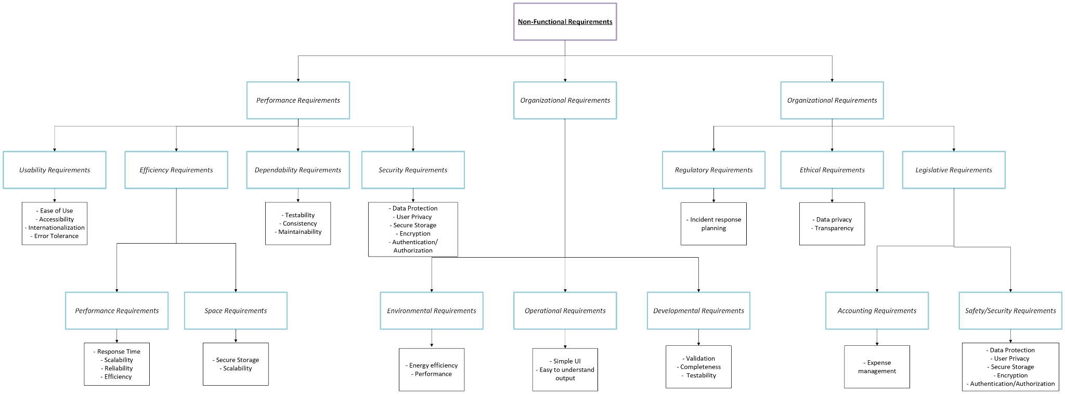
Non-Functional Requirements

Slide 9
03
Diagrams
Use Case Chart/Diagram + Sequence Diagram + Class Diagram

Slide 10
Use Case Chart
ProfFinder - View Professor Summary and Top-Ranked Professors
Actors | Student (primary actor), Chatbot System
Description | A student inputs a Rate My Professor (RMP) link or specifies a course and university to receive professor evaluations. The system scrapes RMP data to provide summaries of pros and cons or ranks top professors
Data | RMP links, course information
Stimulus | User command issued by the student
Response | Summary of professor’s pros and cons or list of top-ranked professors
Comments | The system must handle multiple requests and ensure data accuracy from RMP.

Slide 11
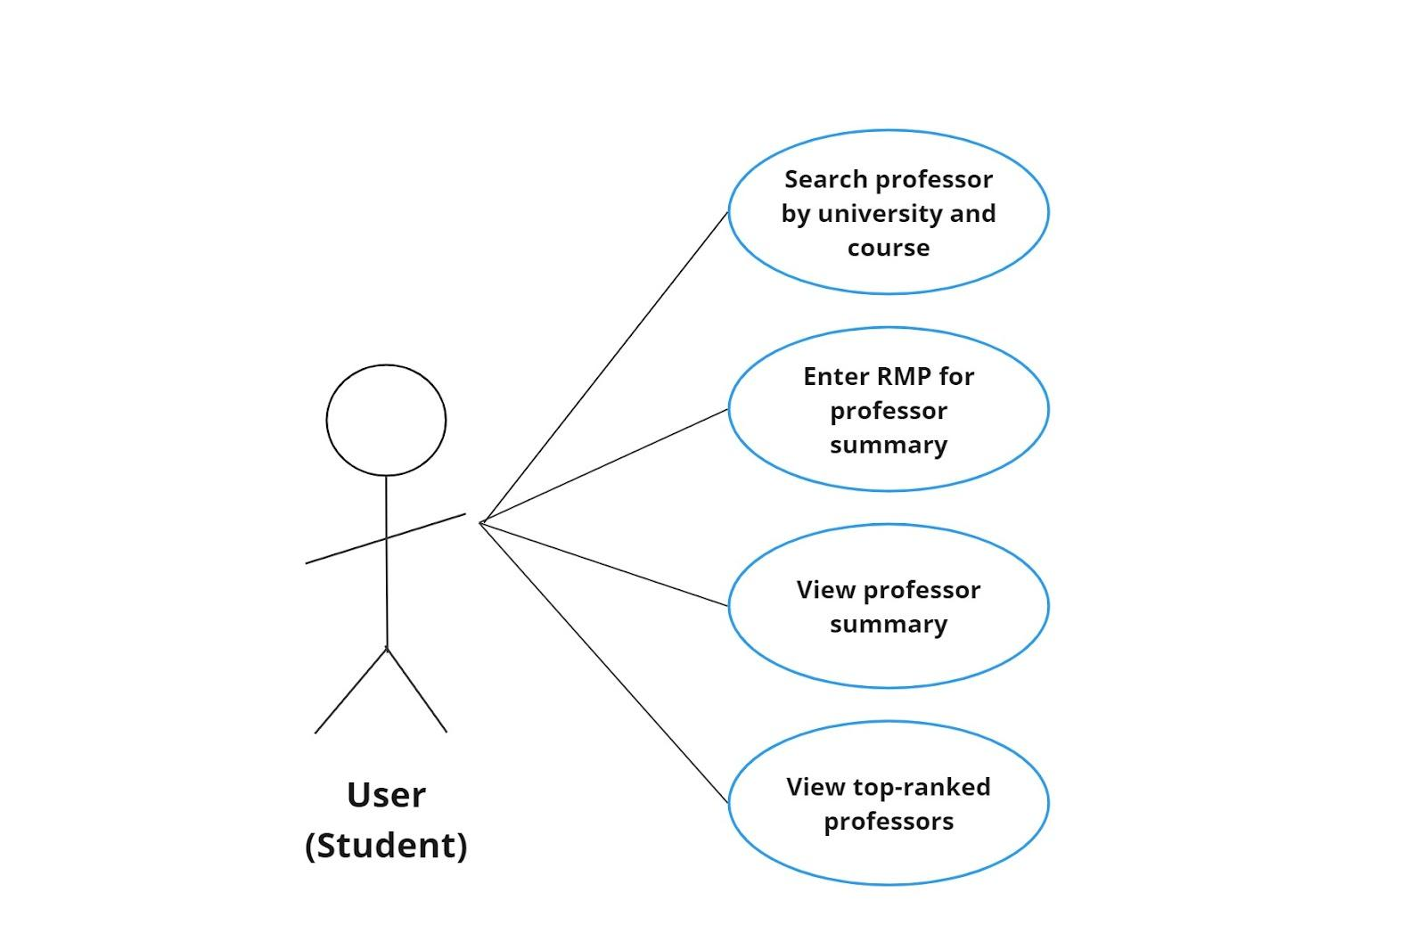
Use Case Diagram
A visual representation of how users interact with a system!

Slide 12
Sequence Diagrams for Our Use Cases
Depicts the interactions between different objects in a system!

Slide 13
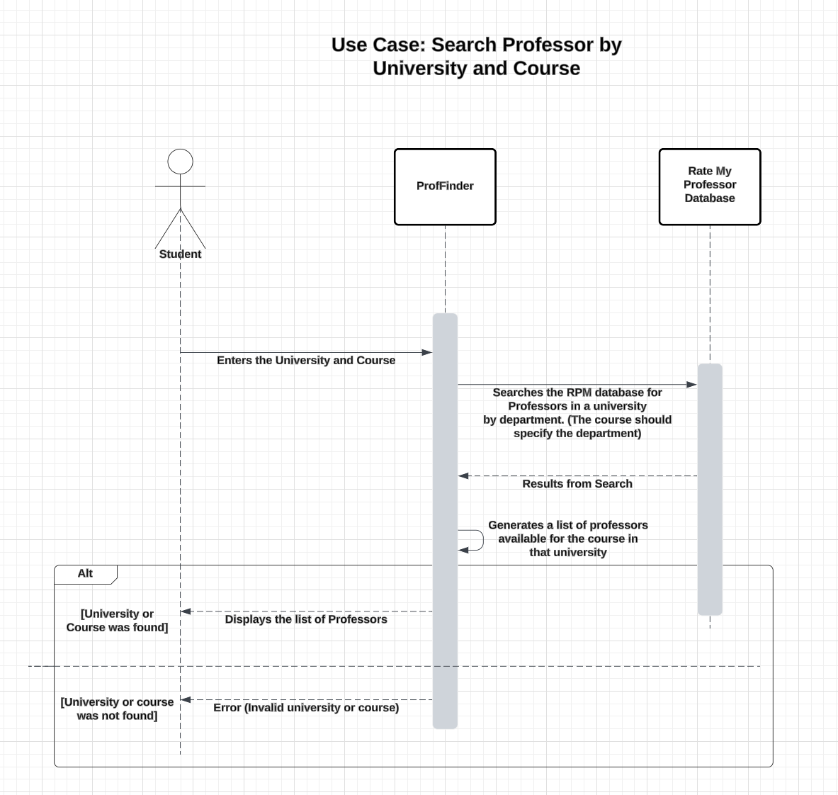
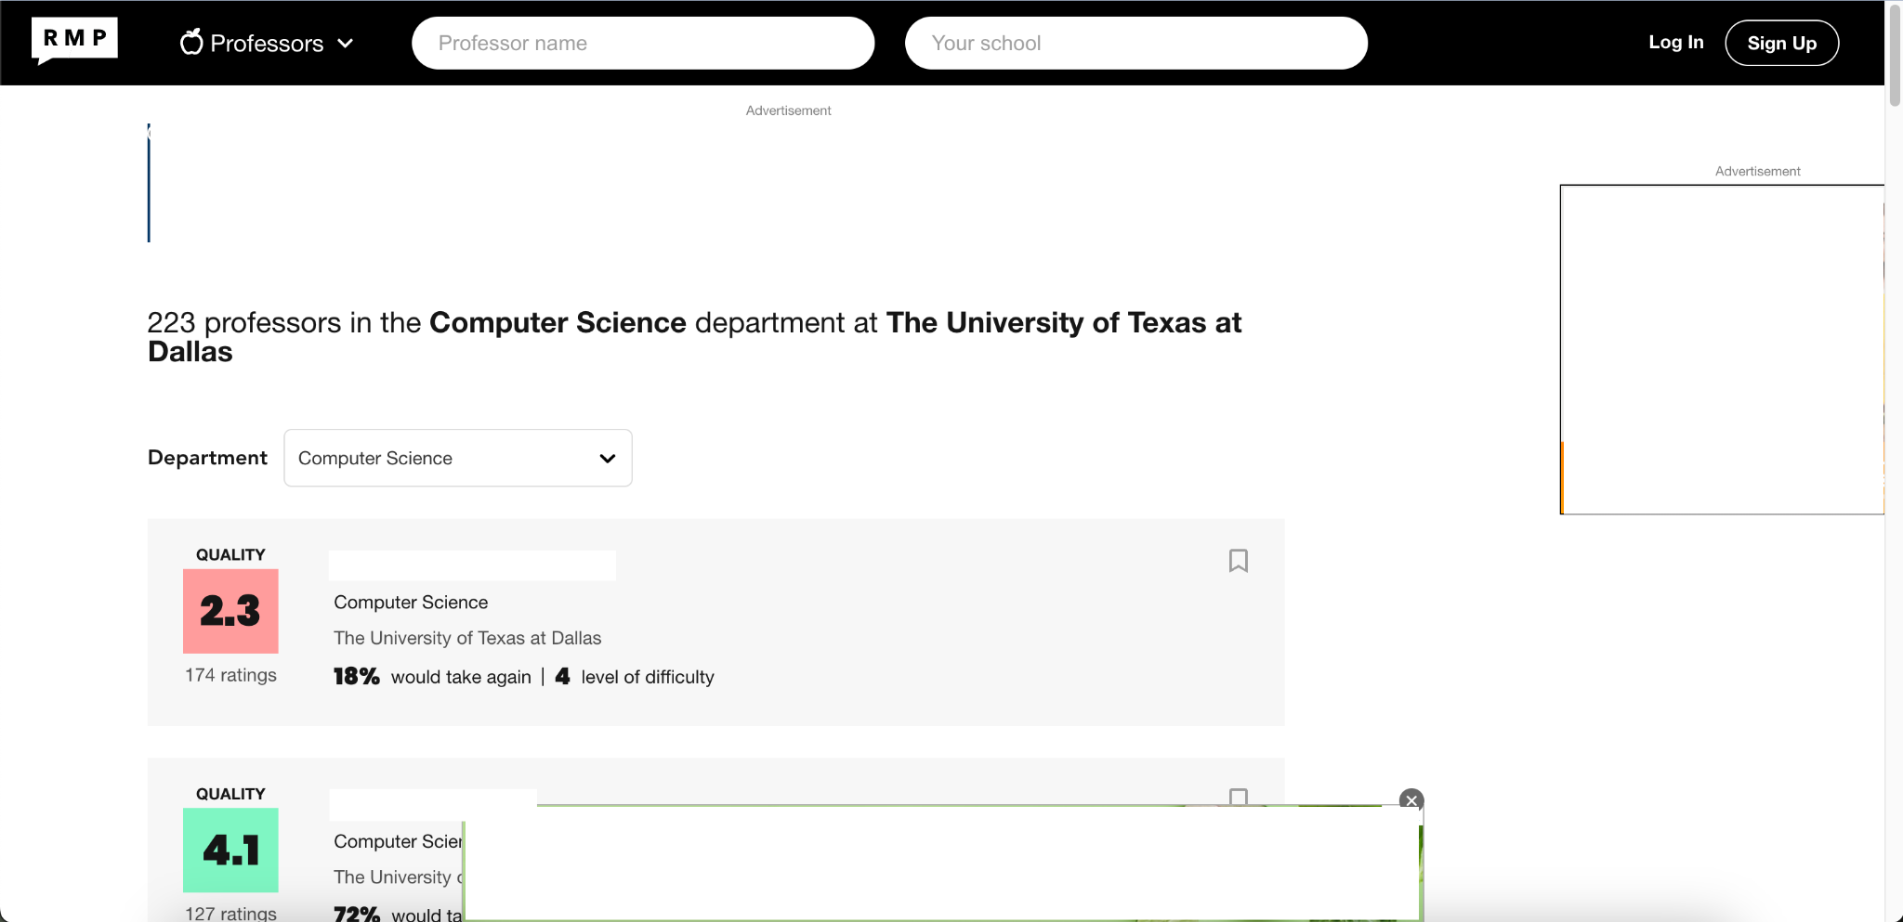
Use case of Searching
Professor by University
and Course
Searching for CS Professors for CS Courses in RMP
Diagram Software: LucidChart

Slide 14
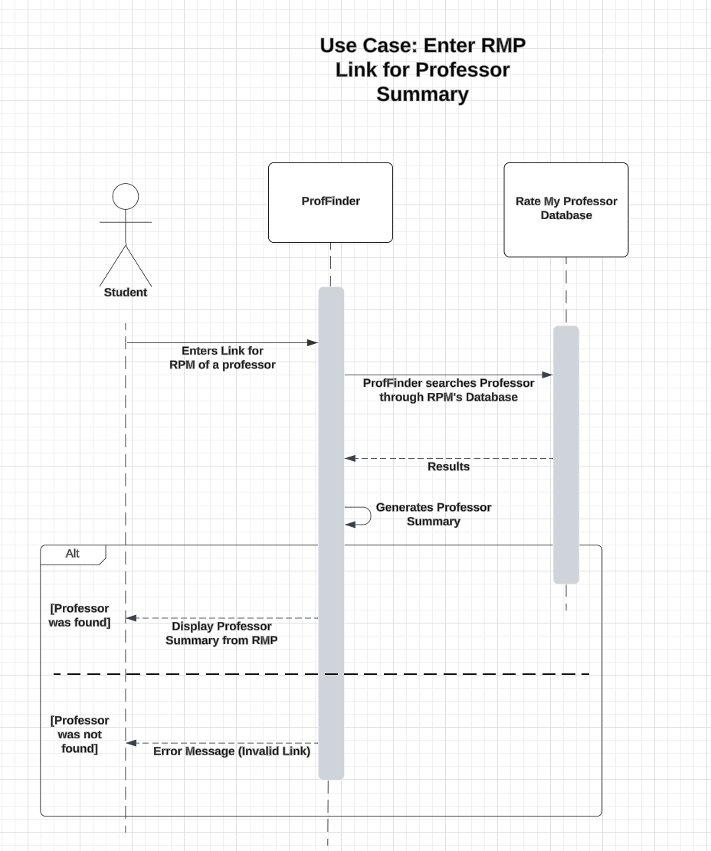
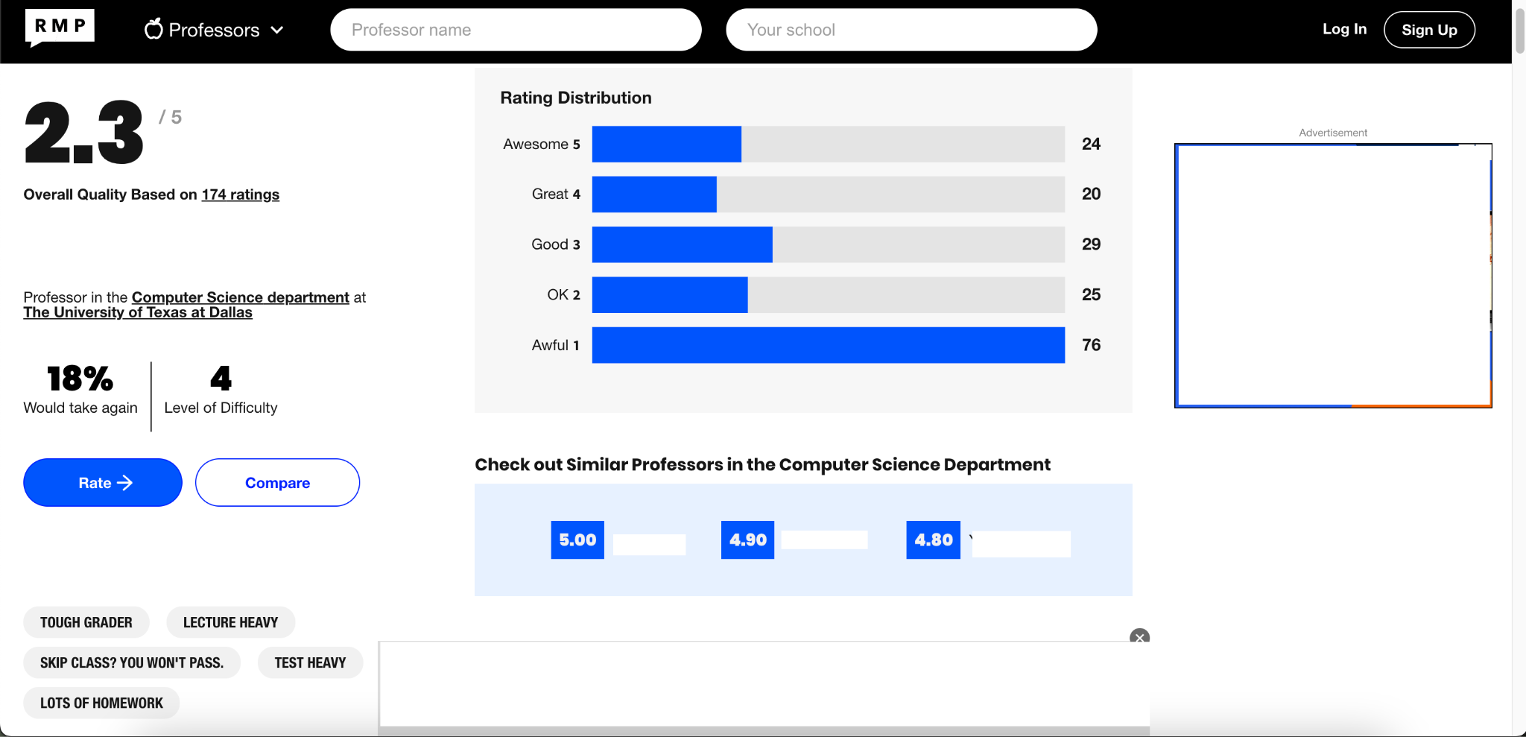
Use case of Entering
Rate My Professor
Link to view
Professor Summary
Rate My Professor Summary
Diagram Software: LucidChart

Slide 15
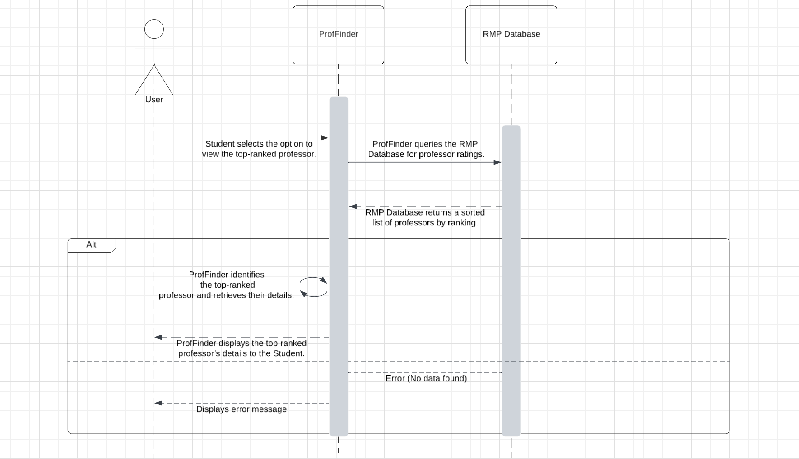
Use case of viewing
Professor Summary
Diagram Software: LucidChart

Slide 16
Use case of viewing
Top-Ranked
Professors
Diagram Software: LucidChart

Slide 17
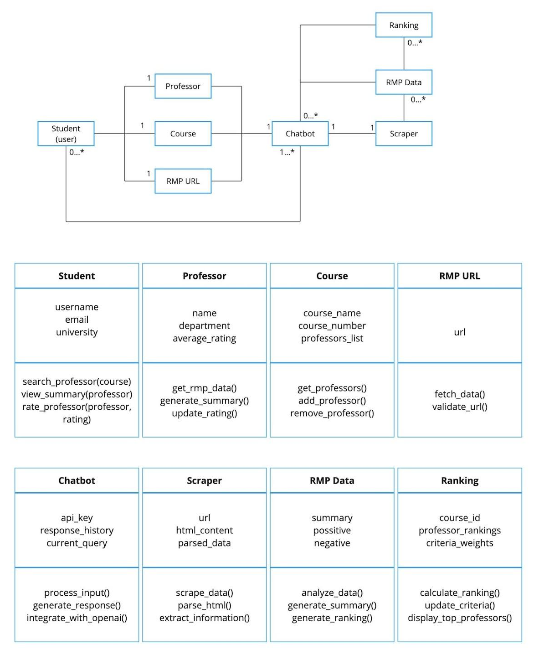
Class
Diagram
Depicts the structure of a system by showing its classes, their attributes (data), methods (functions), and the relationships between those classes!

Slide 18
04
Architectural Design
An early stage of the system design process!

Slide 19
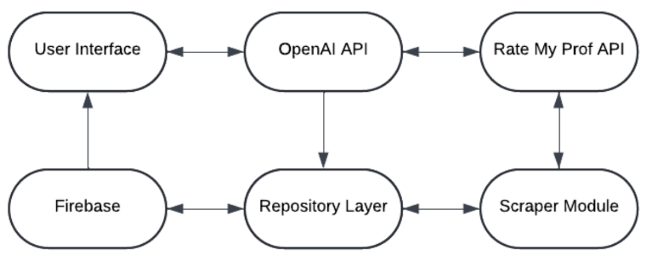
High-Level System Architecture Design

Slide 20
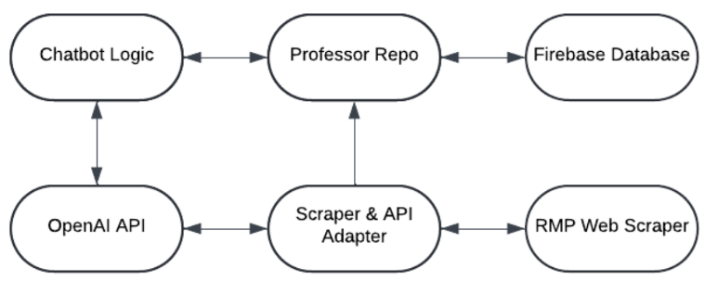
Pipe & Filter Pattern Architecture Diagram

Slide 21
05
Project Scheduling
Process of creating a timeline to ensure that a software project is completed on time!

Slide 22
Project Scheduling
Task | Week 1 | Week 2 | Week 3 | Week 4 | Week 5 | Week 6 | Week 7
1. Planning and Setup
- Project planning, team coordination | X | X
- Set up Firebase and OpenAI API | X
- Initial chatbot framework | X | X
2. Core Development
- Implement basic chatbot functionality |  | X | X
- Scraping capabilities for RMP links |  | X
- Professor ranking functionality based on course and RMP data |  |  | X | X

Slide 23
Project Scheduling Cont.
Task | Week 1 | Week 2 | Week 3 | Week 4 | Week 5 | Week 6 | Week 7
3. User Interaction and Feedback
- Develop user input handling and feedback system |  |  |  | X | X
4. Integration
- Firebase integration for storing user queries and chatbot responses |  |  |  |  | X | X

Slide 24
Project Scheduling Cont.
Task | Week 1 | Week 2 | Week 3 | Week 4 | Week 5 | Week 6 | Week 7
5. Testing and Finalization
- Test scraping and ranking algorithm |  |  |  |  |  | X | X
- Finalize user interface, fix bugs, optimize performance |  |  |  |  |  |  | X
- Final testing, documentation, project presentation preparation |  |  |  |  |  |  | X

Slide 25
Project Scheduling Cont.
Scheduling:
Start Date: January 8, 2025
End Date: March 1, 2025
Duration: 8 weeks (This is estimated based on a team of 8 students each working on ProfFinder 10 hours per week).
Justification:
Each student will work 2 hours per day, 5 days per week (Monday to Friday), for a total of 10 hours per week.
Weekends will not be counted.
The 8-week duration takes into account the scale of the project, complexity of using API, website scraping, and the creation of the chatbot.

Slide 26
06
Costs & Effort & Pricing
Cost + Effort and Pricing Estimation + Project Duration and Staffing

Slide 27
Function Point Method
Function Point (FP) Method for ProfFinder The Function Point (FP) method is a standardized approach to estimate the size, complexity, and effort required to develop software. It measures functionality based on five categories rather than lines of code:
User Inputs: Data entered by users (e.g., course names, professor ratings).
User Outputs: Data provided to users (e.g., chatbot replies, ranked professor lists).
User Inquiries: Requests for data retrieval (e.g., asking for professor information).
Data Files: Internal data storage (e.g., databases).
External Interfaces: Interactions with external systems (e.g., Firebase API).

Slide 28
Benefits of Using Function Point
User Functionality:
ProfFinder offers a simple interface for students to grade professors and retrieve related information.
FP helps measure features directly connected to user interaction, such as scraping RMP data and generating ranked professor lists.
Project Complexity:
FP captures variations in complexity, such as the difference between scraping RMP data (more complex) and simple user input/output tasks (less complex).
Modular Approach:
FP breaks down the functional modules (e.g., Scraping, Ranking, Querying) and measures the effort for each, allowing for more accurate time estimates.
Adaptability:
As the project evolves, FP allows for flexibility by modifying estimates as new features or requirements are added.
Effort Calculation:
FP helps estimate project duration and resource allocation. For ProfFinder, we estimated 7 weeks of work with 9 team members.

Slide 29
07
Estimated Costs
Estimated Cost of Hardware Products & Estimated Cost of Software Products & Estimated Cost of Personnel

Slide 30
Estimated Cost of Hardware Products
The ProfFinder chatbot will be cloud-based, which means that hardware costs will be based on infrastructure used to host and support the application.
Server → Firebase Hosting:
Firebase is used for users' queries and responses; it hosts the history of the users' queries and the application itself. While Firebase offers a free tier, we will have to make consideration for additional server resources as the application scales with use. Hosting costs depend on data storage and API calls made by users interacting with the chatbot. Server Maintenance:
This covers the costs incurred in maintaining the server over time. Maintenance costs could include backups, monitoring, and ensuring the server is available and running at full efficiency. We estimated maintenance costs for a year, which will go a long way in ensuring the application remains operational after deployment.
Hardware Product | Cost (USD)
Server (Firebase Hosting) | $500
Server Maintenance (1 year) | $1,200
Total Hardware Cost | $1,700

Slide 31
Estimated Cost of Software Products
The chatbot natural language features are to be powered by the OpenAI API; costs accrue thereby on token usage or, in other words, the number of queries that a chatbot handles with information generated out of such interactions. In this, we have assumed moderate API usage, considering multiple users interacting with the API. Development Tools (IDE, Libraries):
Although many development tools are open-source, there may be some tools or libraries we would have to procure such as specific libraries used for web scraping, handling data, or testing. The costs will also cover even software for the productivity of development, such as paid versions of IDEs like WebStorm or IntelliJ.
This would also include any third-party proprietary software required for specific tasks; more advanced encryption tools, for instance, or additional API access. Most of the utilities for a student project can be availed from open-source varieties, but a small budget is set aside to accommodate those paid versions.
Software Product | Cost (USD)
OpenAI API (Token Usage) | $250
Development Tools (IDE, Libraries) | $500
Licensed Software | $400
Total Software Cost | $1,150

Slide 32
Estimated Cost of Personnel
Developers: Coding and Testing
The major cost here is in time and effort contributed by 9 team members for coding,
testing, and deployment of the final product. Even though this was work done by students, we estimate what an equivalent cost would be if this were a professional development team. Each would provide coding, design and testing contributions; the estimated cost in this submission represents the value of such effort.
We estimate the total development and testing cost at $45,000 based on typical rates for software developers, assuming the students would work for a set amount of time each week.
Post-Installation Training:
Then the product is complete, a small part of the cost for training its users-in other words, maintaining the system-so that it will be used effectively. This might include documentation, tutorials, or direct assistance in the use of the chatbot system. It would come with an estimated training cost of $1,500 to account for resources spent in helping users or administrators understand how to operate or maintain the chatbot.
Personnel Role | Number of People | Cost (USD)
Developers (Coding and testing) | 8 | $45,000
Training Post-Installation | 1 | $1,500
Total Personnel Cost | 9 | $46,500

Slide 33
08
Test Plan
Describing the test plan for testing!

Slide 34
Test Plan
The Focus of the Test Plan
The test plan for `getProfessorData` focuses on validating its ability to fetch and parse data from a professor's RateMyProfessor page.
It includes two key test cases: successful data retrieval with expected properties (`name`, `rating`, `comments`), and error handling when the page cannot be accessed. Using Jest, we ensure that `getProfessorData` reliably returns expected data or raises an error if the fetch fails. This plan verifies the function's core functionality, providing a stable foundation for other components that rely on this data.
Example Explanation
For example, the `getProfessorData` function was tested with two cases: successful data retrieval and error handling. In the first case, a URL returned expected professor data (`name`, `rating`, `comments`), and the function passed by returning the correct object.

Slide 35
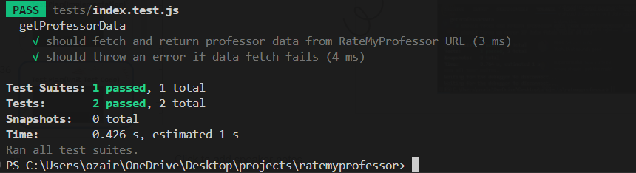
Test Plan

Slide 36
09
Comparison
Comparing other similar products on the market!

Slide 37
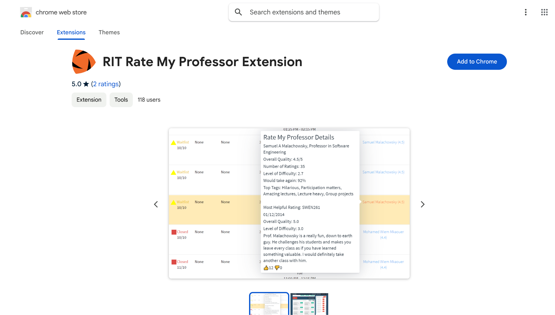
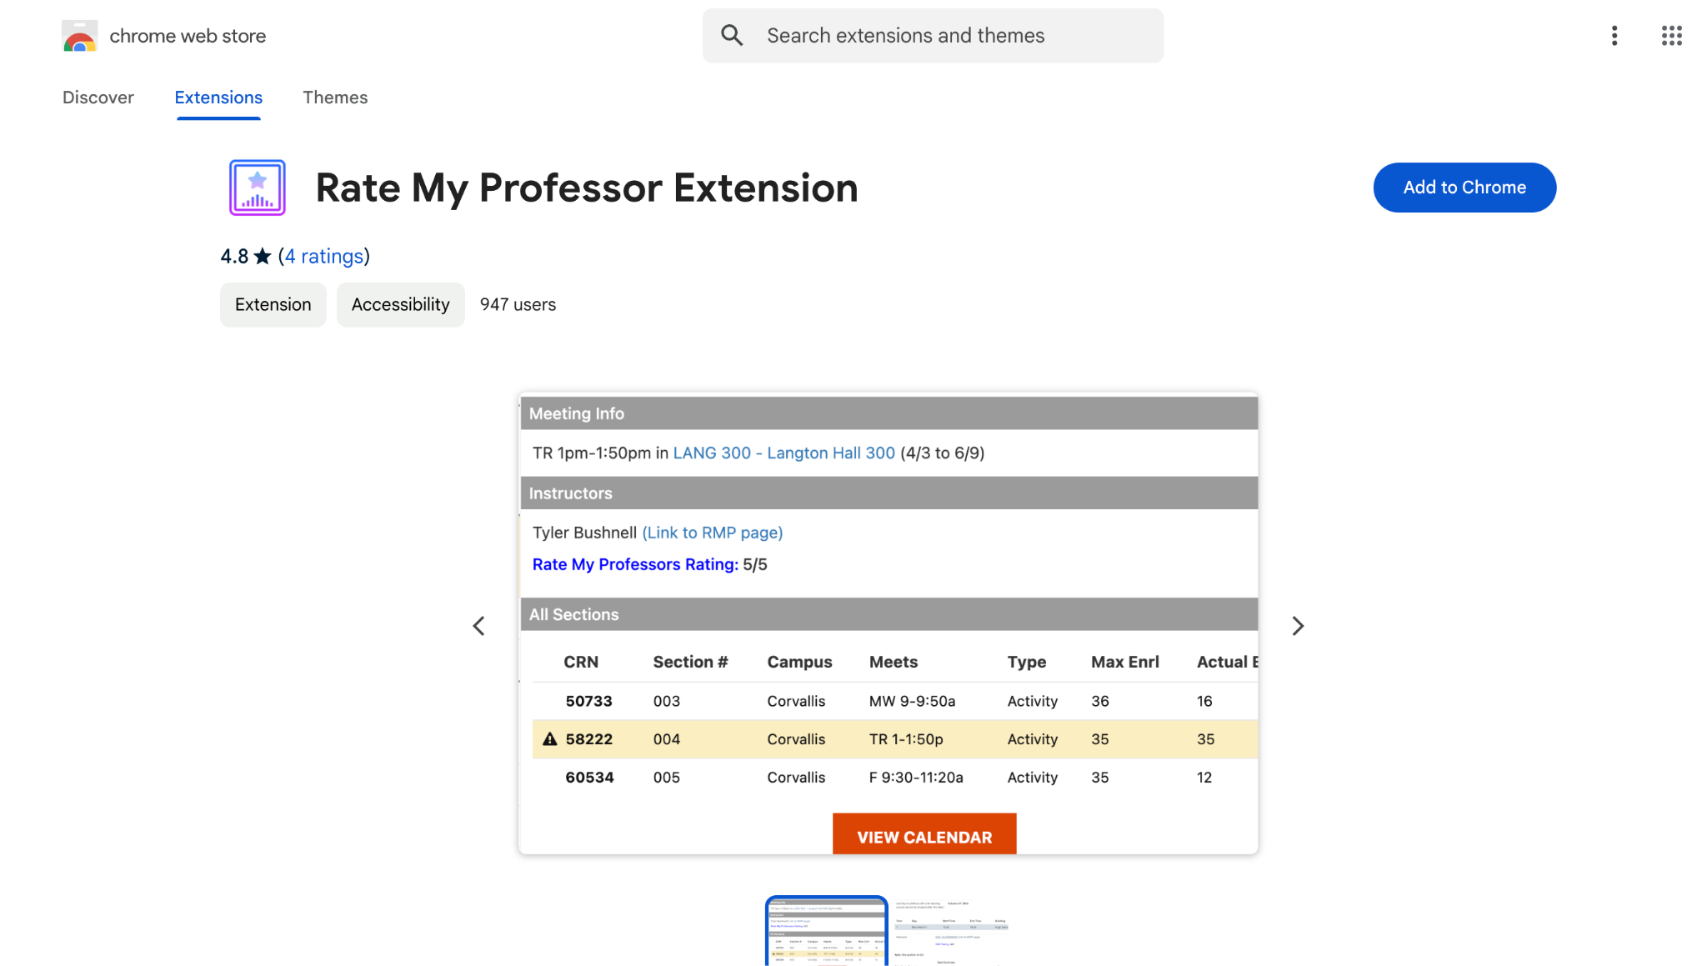
Competitor Comparison
There are other programs that are trying to achieve the same goal we are trying to achieve here. One of those is the RIT Rate my Professor extension on Google. The problem with this program is it only works on the Rochester Institute of Technologies course book. We are designing our project to work on not only UTD's schedule planner, but also other schools as well. There is also another Google extension called Rate My Professor Google Chrome extension. This doesn't have the same functionality as our project because it only shows a 1 through 5 rating of the professor and doesn't give the students detailed information about what kind of professor they are. There was also another program named Whiteboard that used to be made for UTD specifically, but it has been discontinued and removed from Google. Our project stands out because we are making a more general helper for students through the registration process that will not only help UTD students, but all students with detailed professor information.

Slide 38
10
Conclusion
Ending off our presentation!

Slide 39
Conclusion
With ProfFinder, we set out to make choosing the right professor easier and more informed for students. By pulling together feedback and data from Rate My Professor, ProfFinder offers a quick, reliable way to help students find professors that best fit their learning needs.
Our goal is to empower students with accessible information so they can make confident decisions in their academic journeys. We believe ProfFinder has the potential to create a more transparent and supportive experience for students everywhere.

Slide 40
11
References
All of the resources we used!

Slide 41
References
Websites
[1] I. Somerville, Software Engineering - Global Edition, 10th ed., Pearson Education Limited, 2019.
[2] “Pricing plans,” Firebase. Google, [Online]. Available: https://firebase.google.com/pricing. [Accessed: November 1, 2024].
[3] “Pricing” OpenAI. [Online]. Available: https://openai.com/api/pricing/. [Accessed: November 1, 2024].
[4] “What does a Product Manager *Really* Do & How is the Role Changing?,” Heap. [Online]. Available: https://www.heap.io/topics/what-does-a-product-manager-do‌ [Accessed: November 10, 2024].
[5] Maryna Panchuk, “Front End vs Back End Developer Salary: Comparing Across IT Companies,” Alcor BPO, May 04, 2023. [Online]. Available: https://alcor-bpo.com/front-end-vs-back-end-developer-salary-comparing-across-it-companies/. [Accessed Nov. 11, 2024].
[6] RIT Rate My Professor Extension. Chrome Web Store. July 24, 2023. [Online]. Available: https://chromewebstore.google.com/detail/rit-rate-my-professor-ext/lcionigofpcbfpmnipnioapimoggnbda?pli=1 [Accessed: November 7, 2024].
[7] Rate My Professor Extension. Chrome Web Store. March 30, 2024. [Online]. Available: https://chromewebstore.google.com/detail/rate-my-professor-extensi/hgfogfefocfabnfjmjijfcjogeghmocn. [Accessed: November 7, 2024].
Photos
https://www.webfx.com/blog/marketing/what-is-openai/
https://fitchburgpoint.com/12801/opinion/ratemyprofessor-bashing-or-useful/
https://firebase.google.com/

Slide 42
THANK YOU!
Any Questions?

